Slide 1
Data Acces Application Layers
Divide and conquer
Complexity
Testability

Slide 2
Data Access

Slide 3
Data Access, really

Slide 4
The standard layers
Presentation
Business
Adapting to Client
Client Connection
Formats
Following Rules
Do/Die decisions
Security
Protocols
Encodings
Data Access
Data Storage
Authenticate
Auditability
Logical Data Model
Query & Operations
Concrete Data Access
Logical Context
IUnitOfWork
Abstract, Uniform Data Access
IRepository
(Physical) Data Model
ACID Properties?
CRUD

Slide 5
Architecture
Presentation
Historic: IRepository<TEntity>
UnitOfWork
Data Storage
MVC Controller
Odata
SignalR Hub
Business
Data Access
Configure Data Access to restrict actions
Expose entities individually
Expose queryable entity model
Expose live changes to entities
Individual/Collected?
Coordinate do/die across system
Security
Authorize & audit changes
Distribute changes
Coordinate between different sources that depend on changed
May be different from Data Storage model
JSON/XML/Parquet
JSON/Protobuf/…
Preferably IQueryable<T> access
Live: IQbservable<TEntity>
EFC2: DbContext
Files: Custom
ServiceBus/MQ: IQbservable
…

Slide 6
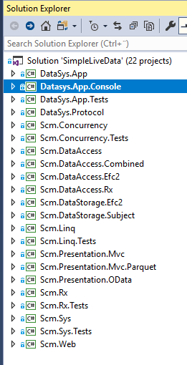
SimpleLiveData https://github.com/slogen/SimpleLive
Presentation
Business
Data Access
Data Storage
MVC
Odata
SignalR
Simplified ☺
Repository
IQbservable
Toy Model
EFC2
Subject
Testability
Client to webserver with InMemory storage
Full integration
Adapts *actual* confg
OAuth2
OAuth support

Slide 7
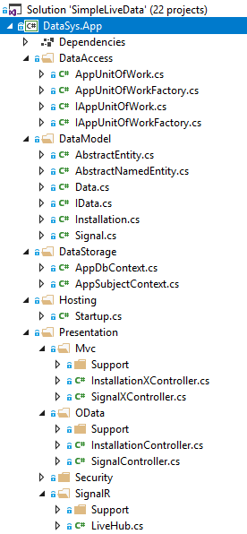
SimpleLiveData App
“Instantiates” the layering into folders
Showcases
IUnitOfWork
IRepository<TEntity> (with IQueryable<TEntity>)
Historic and Live coordination (“Business”)
MVC compact exposure of Entities
OData exposure of logical model
Live exposure of data
Variable MVC formatters (JSON, Parquet)
Full-stack integration testing

Slide 8
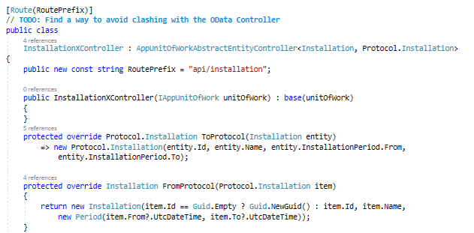
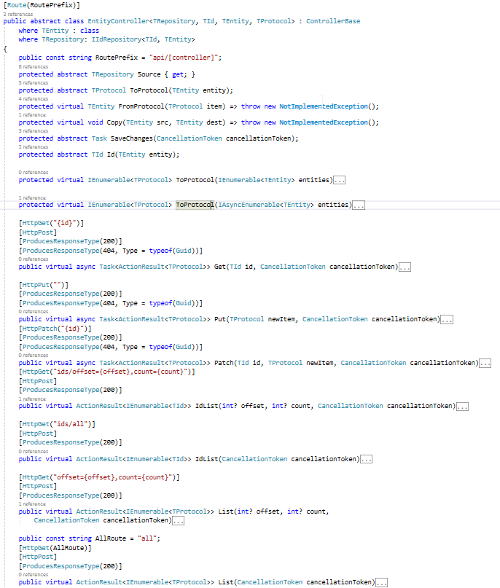
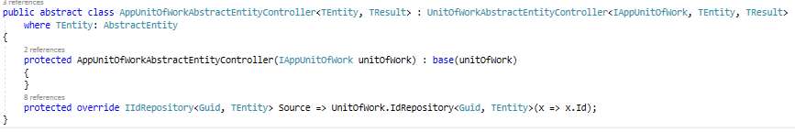
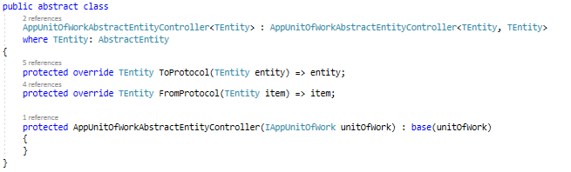
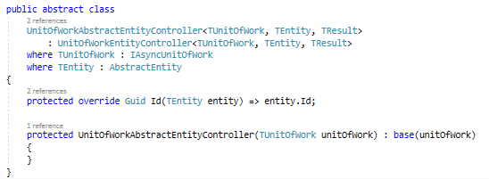
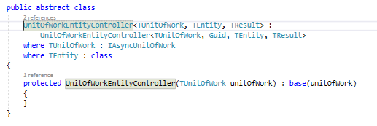
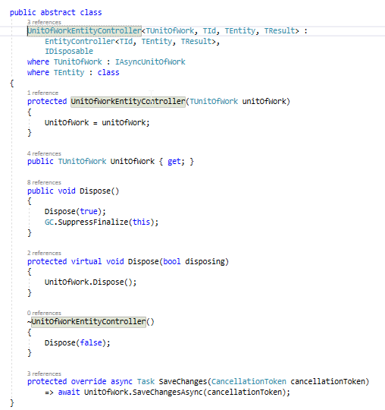
MVC

Slide 9
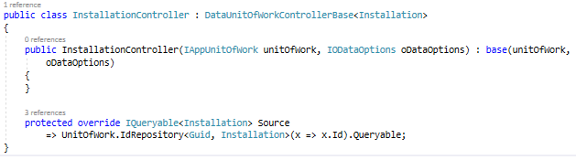
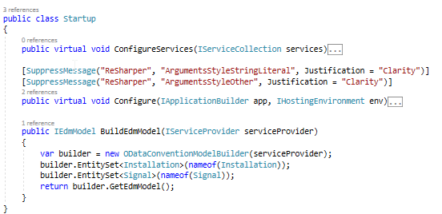
OData

Slide 10
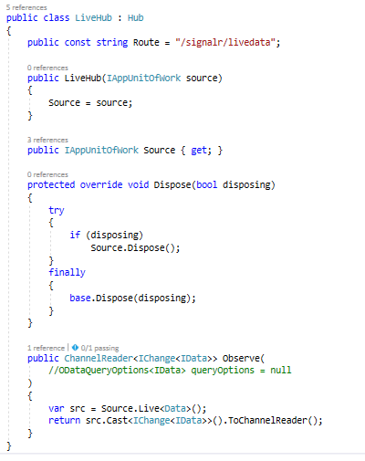
SignalR (WIP)

Slide 11
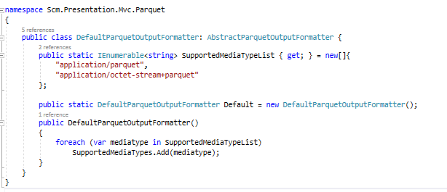
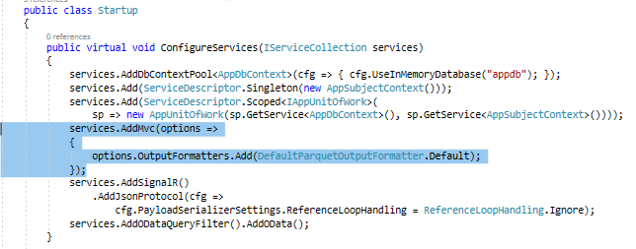
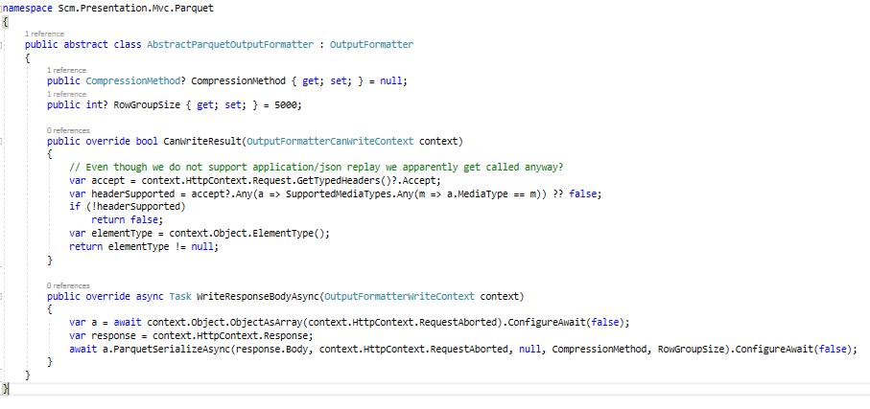
Parquet

Slide 12
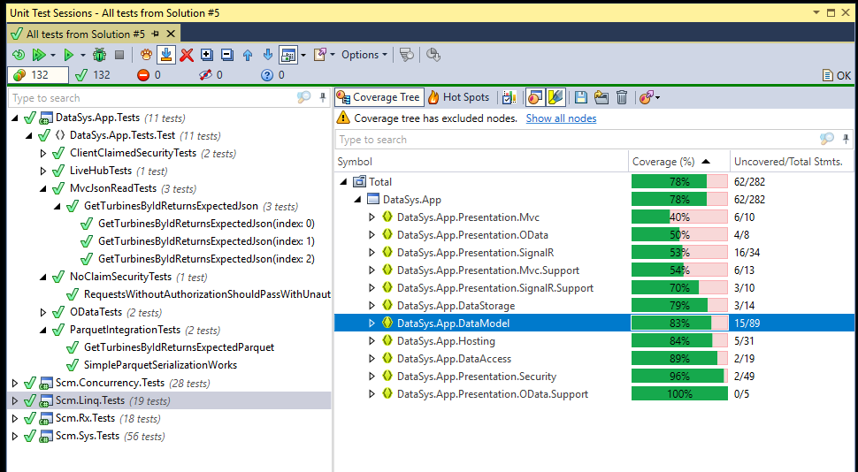
Test Coverage -- OK for demo ☺

Slide 13
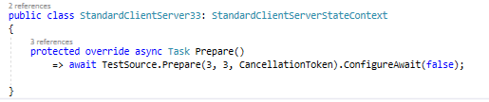
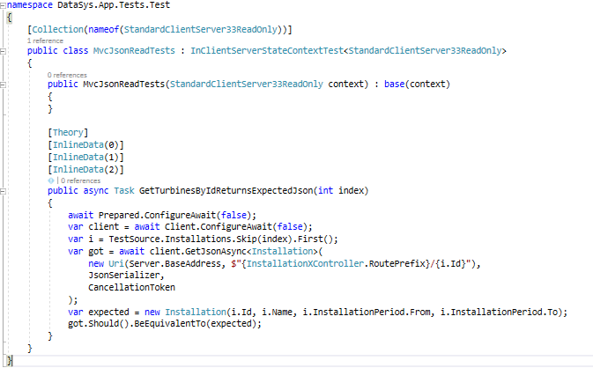
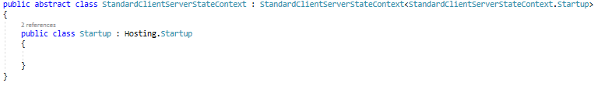
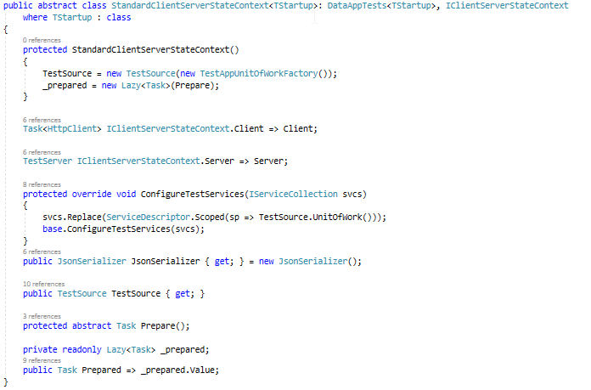
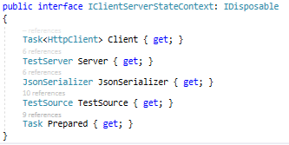
Example Test

